Slide 1
Fragrance
by Ariel Thorpe and Sandeep Bains

Slide 2
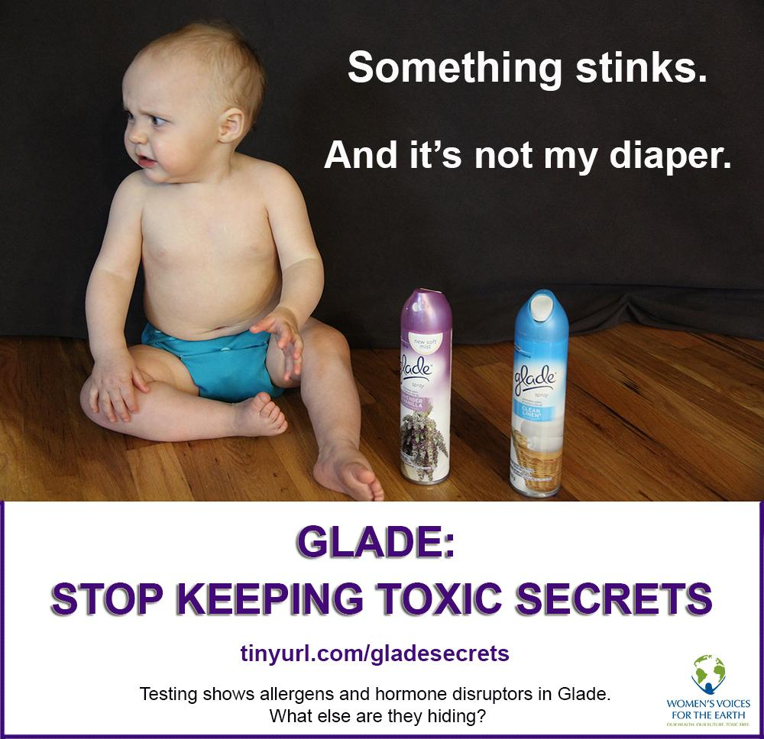
Clean Research Question
What are the effects
of “fragrance” on
the human body?

Slide 3
What is the toxin?
Fragrance AKA Parfum AKA Aroma AKA Musk AKA Synthetic Musk
Fragrance Mix-I:
Amyl Cinnamal
Cinnamal
Cinnamyl alcohol
Eugenol
Evernia prunastri (oak moss) extract
Geraniol
Hydroxycitronellal
Isoeugenol
(With sorbitan sesquioleate as an homogeniser)
Myroxylon pereirae (Balsam of Peru)

Slide 4
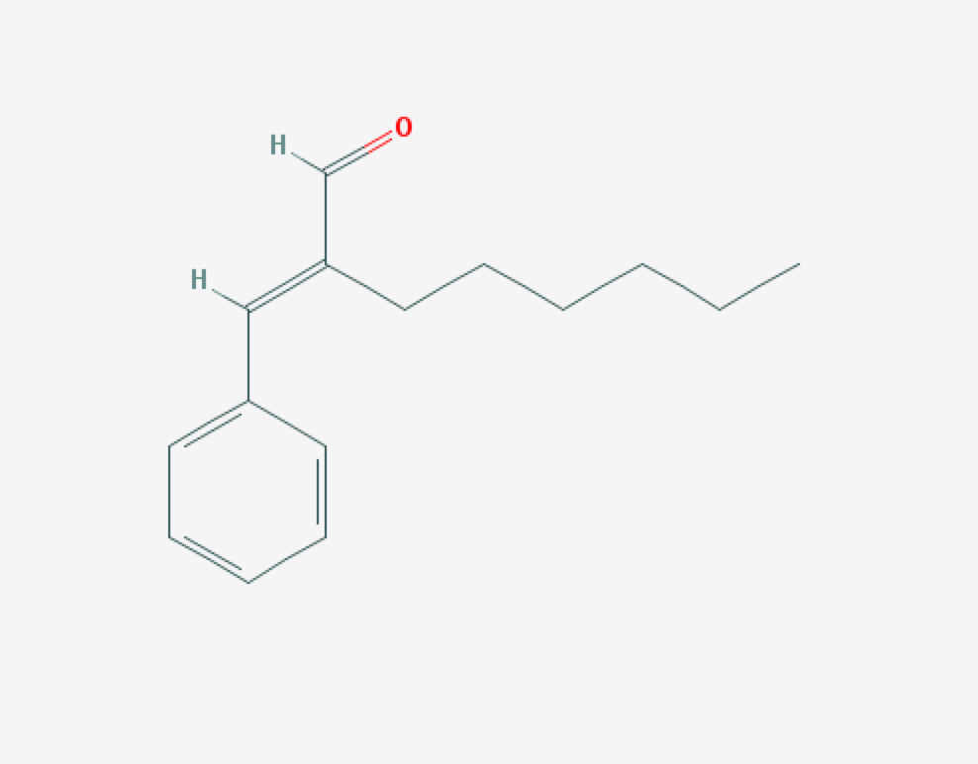
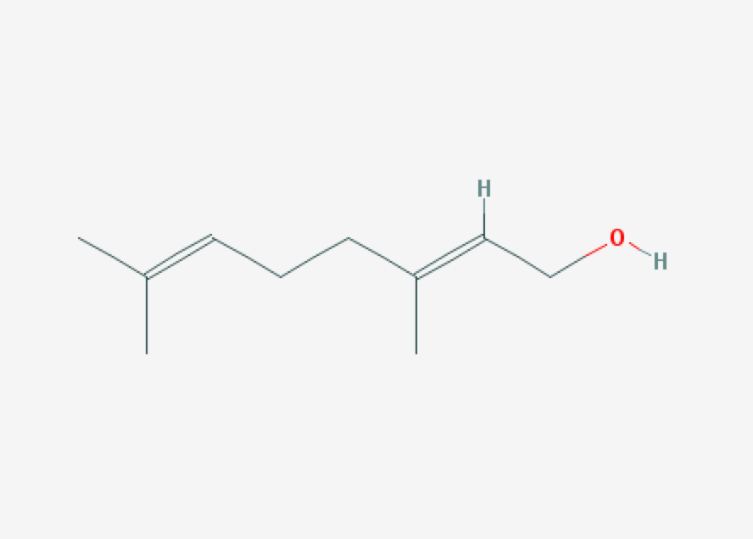
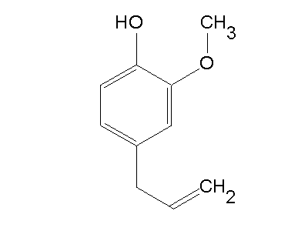
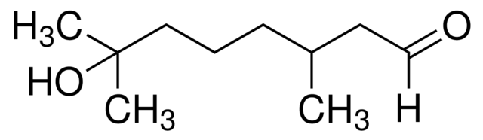
Chemical Structure
Cinnamal
Geraniol
Hydroxycitronellal
Eugenol

Slide 5
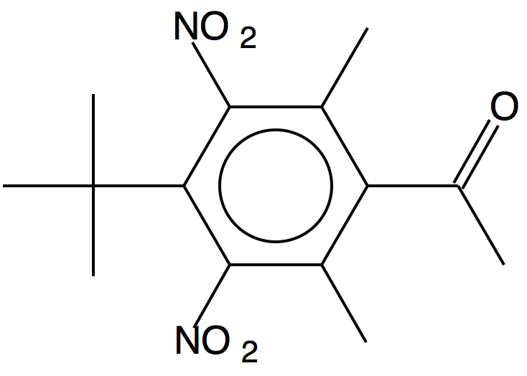

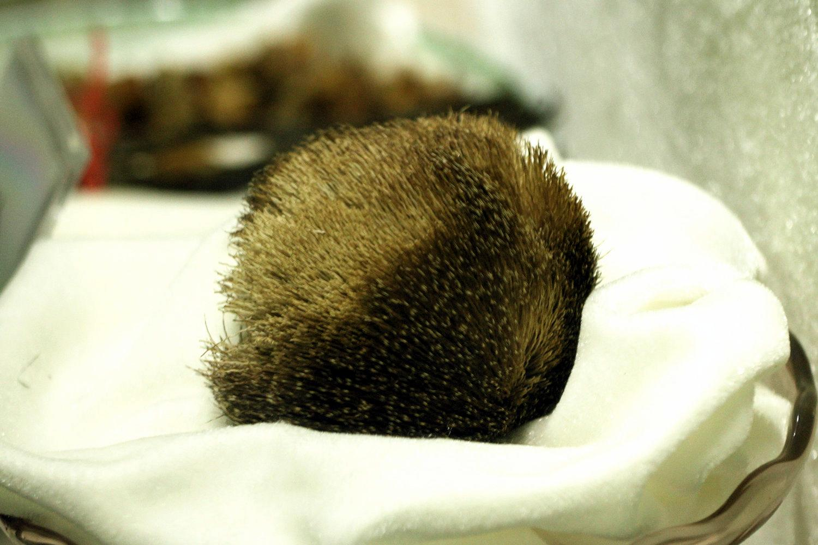
Natural Compound Mimicked
Musk from the Musk Deer

Slide 6

Where is it found/how are we exposed?
Perfumes
Cosmetics (lotion, make up)
Detergents
Garbage bags
Cologne
etc…
Allergic contact dermatitis = major cause of occupational skin disease.
Approx. 20% of all work-related health complaints.
Estimated 4 million lost work-days
Associated cost of almost $400 million per year (United States)

Slide 7
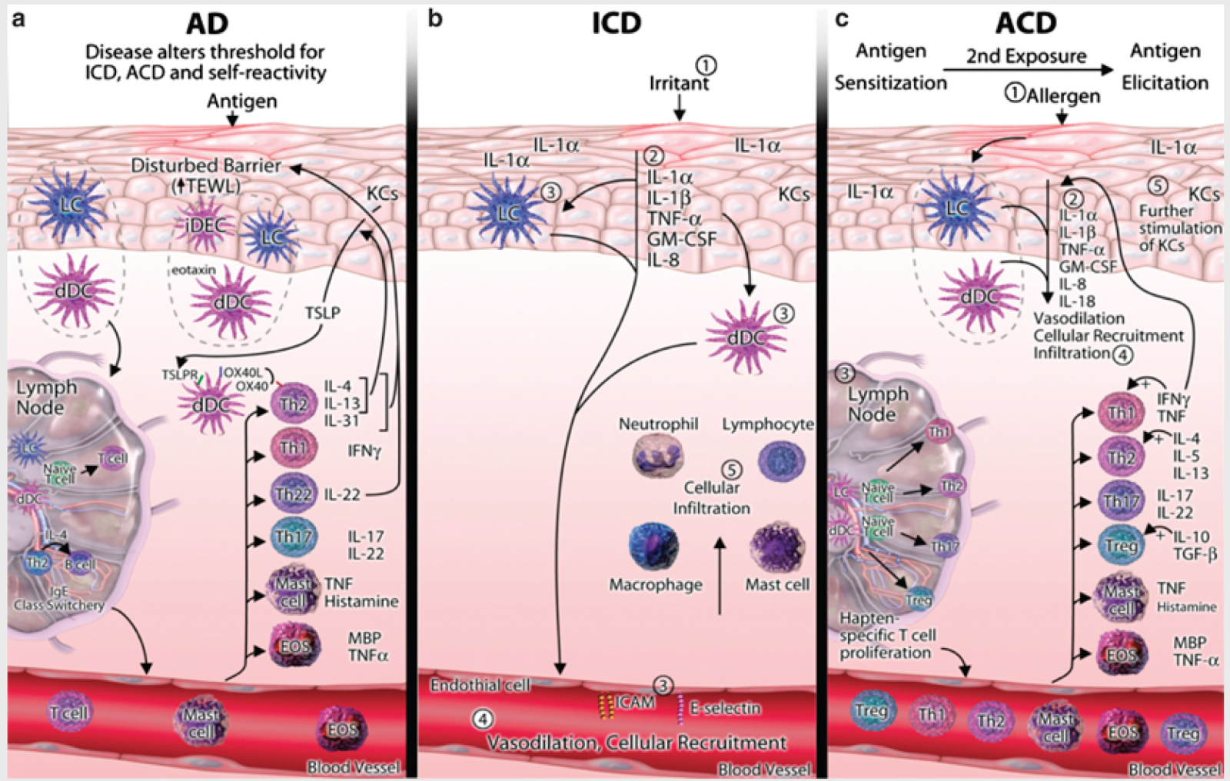
Mechanisms of Action & Target Organ
Skin
Allergic
Response
Contact
Dermatitis

Slide 8
Mechanism Broken Down
Contact to epidermis
Antigens permeate
Antigens meet Langerhans cells (LC), dermal dendritic cells (DC)
Activate helper T type 2 cells (Th2)
Produce interleukin 4 & 13
Stimulate keratinocytes
DCs & Th2s stimulate cytokines and chemokines
Barrier defects and immune response
Inflammatory cascade
LCs and DCs activate T cells in lymph
Now we have an allergy forever

Slide 9
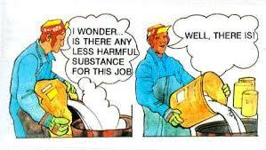
Dose-response for toxic action & injury
Generally safe exposure level: 0.8 μg/cm2 = 0.01% = 100 ppm
For comparison:
Body lotion: 7.82g per day (499 μg/cm2 daily)
Aerosol spray deodorant: 1.43g per day (7150μg/cm2 daily)

Slide 10
How is the toxin metabolized/eliminated?
From a study (submitted to the EPA by a consortium of chemical companies) of ORAL doses of geraniol, nerol, and citronellol:
Hydrolysis → alcohol oxidation → omega-oxidation → hydration → selective hydrogenation → conjugation → oxygenated polar metabolites → urine
Oxidation → carboxylic acids → beta-oxidation pathway → cleavage → carboxylic acids → carbon dioxide

Slide 11
Biological half-life
Limited data in humans.
1,8-cineol from rosemary oil: 104.6 minutes (in blood)
Fish:
Musk ketone: 2.2-2.6 days
Other musks: 1-3 days.

Slide 12
Risk of exposure & prevalence
North American Contact Dermatitis Group reports: 9.1% reaction to fragrance mix-1 (2004)
Europe: 8.3% reaction to fragrance mix-1 (2004)

Slide 13
Care Management to Reduce Risk
Choose Fragrance-Free NOT Unscented items
Read ingredients
Have a fragrance-free office
Creams as barriers between skin and toxins but they are not very effective
Coconut oil is a natural antimicrobial

Slide 14
Sources
Consumer Safety. Opinion on fragrance allergens in cosmetic products. http://ec.europa.eu/health/scientific_committees/consumer_safety/docs/sccs_o_102.pdf
The Flavor and Fragrance High Production Volume Chemical Consortia. Test Plan for Terpenoid Primary Alcohols and Related Esters. http://www.epa.gov/opptintr/chemrtk/pubs/summaries/terprial/c12965tp.pdfScientific Committee on
Fowler JF, Fisher AA. Fisher’s Contact Dermatitis. PMPH-USA, 2008.
Jager W et al. Pharmacokinetic studies of the fragrance compound 1,8-cineol in humans during inhalation. Chem Senses. 1996 Aug;21(4):447-80.

Slide 15
Kaplan DH et al. Early events in the induction of allergic contact dermatitis. Nat Rev Immunol. Jan 13, 2012; 12(2): 114–124.
Nikhil Dhingra, Nicholas Gulati and Emma Guttman-Yassky. Mechanisms of Contact Sensitization Offer Insights into the Role of Barrier Defects vs. Intrinsic Immune Abnormalities as Drivers of Atopic Dermatitis. Journal of Investigative Dermatology (2013) 133, 2311–2314; doi:10.1038/jid.2013.239
Ogbolu DO et al. In vitro antimicrobial properties of coconut oil on Candida species in Ibadan, Nigeria. J Med Food. 2007 Jun;10(2):384-7.
Swedish Society for Nature Conservation. Foundations concerning criteria for
BRA MILJÖVAL. Fragrances 2000. http://www.leffingwell.com/rap-bmv-fragrances2000.pdf
Taylor KM et al. Human exposure to nitro musks and the evaluation of their potential toxicity: an overview. Environ Health. 2014; 13:14. http://www.ncbi.nlm.nih.gov/pmc/articles/PMC4007519/#B10

